Slide 1
EECS 233
Introduction to Data Structures
Michael Rabinovich

Slide 2
Welcome to EECS 233
An introductory CS course in computer science.
Primary objective:
  An introduction to various methods of organizing large amounts of data
  Simple analysis of algorithms that use these methods
  Improvement of programming skills
The instructor: Michael Rabinovich
  Email: michael.rabinovich@case.edu
  Office: Olin 507
  Office Hours: Tuesday, 2:30-3:30pm
Teaching assistants: TBA

Slide 3


Prerequisites
ENGR 132
Good knowledge of Java programming
  Comfortable with object-oriented programming concepts
  If your programming skills are not good, expect to put more sweat into the course
  But: EECS 233 is not about programming skills only, it is mainly about data structures and simple algorithm analysis
Some mathematics background
  Mostly simple algebra, understanding the basics of exponents and logarithms, etc.
  Some simple calculations, and growth rate of expressions
    1+2+3+…+1000=?
    What grows faster, or ?

Slide 4
Textbook
Data Structures and Algorithm Analysis in Java (2d or 3d Edition), by Mark Allen Weiss, Addison-Wesley
But lecture notes + Internet will do!
  If using Internet, beware of differences in formulations, terminology, and algorithm flavors

Slide 5
Course Requirements
Attendance of lectures
Programming assignments, 25%
  4 assignments
  Electronic submissions (Blackboard dropbox)
  File name format: P1_YourCaseID_YourLastName.zip
Written assignments, 20%
  4 assignments
  Electronic submissions (Blackboard dropbox)
  Scan your drawings if needed
Midterm exam, 20%
Final exam, 35%

Slide 6
Policies
---------- Forwarded message ----------
From: NSF CDI <cdi@nsf.gov>
Date: Jan 11, 2008 5:06 PM
Subject: CDI preliminary proposals submitted after deadline (1/8/08,
5:00pm proposer's local time)
To: koyuturk@eecs.case.edu
Cc: "Feldman, Jean I." <jfeldman@nsf.gov>, NSF CDI <cdi@nsf.gov>
Dear Dr. Koyuturk,
You are receiving this message because you are the PI of record on a CDI preliminary proposal that was submitted in response to solicitation NSF07-603 after the deadline of Tuesday, January 8, 2008, 5:00 p.m. proposer's local time. Your proposal 0816683 will be returned without review for failing to meet the deadline.
Some proposals that were submitted after the deadline have been accepted for review, and some have not. The reason for the two categories is as follows. As you may be aware, there were a number of reports of slow response from FastLane on Tuesday. The situation has been thoroughly investigated by FastLane technicians at NSF. Substantial delays occurred between 3:30 p.m. and 5:20 p.m. EST. After 5:20 the system returned to normal speed. It is clear from the pattern of submissions that this significantly affected the ability of proposers in the Easterntime zone to meet the deadline of 5:00 p.m. EST. It is also clear that other time zones were not materially affected, as the scattering of a small number of late submissions was typical of a normal deadline day. In particular, the Central time zone, with a deadline of 6:00 p.m. EST,was not materially affected. Thus, any ripple effect from the slowperiod had ended by 6:00 p.m. EST.
Accordingly, CDI has extended the deadline for the Eastern time zone from 5:00 p.m. EST to 6:00 p.m. EST, Tuesday, January 8, 2008, and has left the deadlines for other time zones unchanged. The proposals that are accepted (pending any other compliance issues) were all submitted from the Eastern time zone between 5:00 p.m. and 6:00 p.m. EST on January 8.
Sincerely,
NSF CDI
Grading - will be posted on Blackboard
Late and missed submissions
  10% off each calendar day for 3 days
  not accepted after 3 calendar days
  e.g., due midnight Thursday – 23:59:59pm, submitted on Saturday, graded at 90 points: receives 90*80%=72 points
Academic conduct - see statement on Blackboard

Slide 7
What’s EECS 233?
We’ll be studying fundamental data structures, as well as an introduction to algorithms that use these data structures to solve common problems correctly and efficiently.
What is a data structure? A way of organizing a collection of information or data
  Sequences: lists, stacks, and queues
  Trees
  Hash tables
  Graphs, etc
What is an algorithm? A method to solve problems
  A procedure: takes an input and produces results
  Provides step-by-step “instructions” for solving a problem or accomplishing a task

Slide 8
Example : Searching in a phonebook
Data structure: phonebook representation
  an array of 1,000,000 names (names[0..999999]) and an array of corresponding telephone numbers (phones[0..999999])
Algorithm:
  the procedure to find the telephone number by name
  findNumber(person) {
  P = 0
  while (P < 1000000) {
  // Compare the P-th person in the array and person
  if (names[P] == person)
  return phones[P]
  else
  P++
  }
  return NOT_FOUND
  }
How many iterations are required, on average?

Slide 9
Example cont’d:
Same problem, different data structure
Different data structure: a sorted array by name alphabetically, names[0..999999], and the corresponding array of numbers, phones[0..999999]
  findNumber(person) {
  low = 0
  high = 999999
  while (low <= high) {
  P = floor((low + high) / 2)
  if (person == names[P])
  return phones[P]
  else
  if (person < names[P])
  high = P – 1
  else
  low = P + 1
  }
  return NOT_FOUND
  }
How many iterations are required, on average?

Slide 10
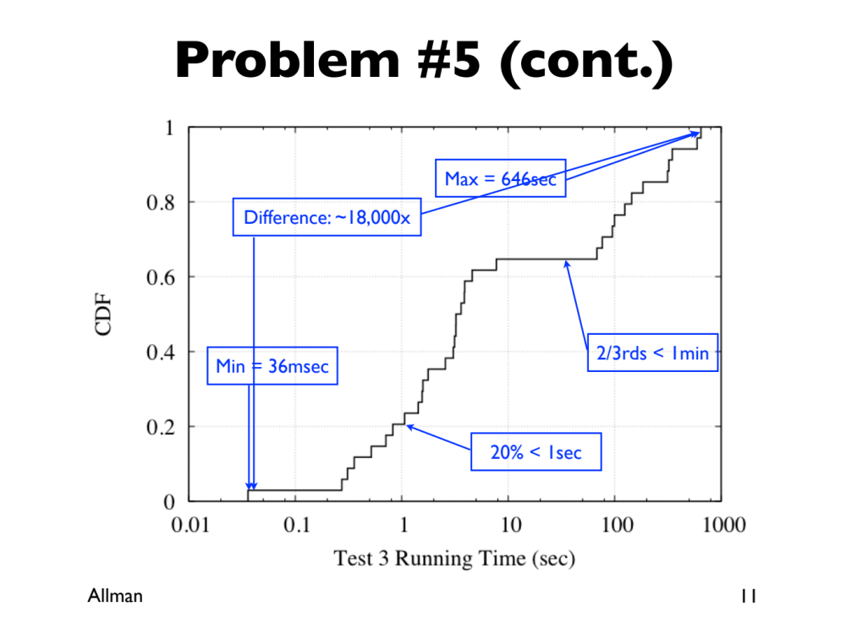
(From Mark Allman)

Slide 11
Example cont’d: So What to Use?
Is a sorted array always better?
We may need to efficiently perform different operations:
  search for a telephone number
  insert a new telephone number
  remove a telephone number
Some data structures provide better performance than others for a particular application.
More generally, we’ll learn how to characterize and compare the efficiency of different data structures and their associated algorithms to perform different operations (for different applications).
  Time efficiency: how many steps are needed?
  Space efficiency: how much storage is needed?

Slide 12
Computer System Storage
Data structures organize data, which is stored in computer systems
  We need first understand computer storage management: CPU cache, memory, disk (or SSD).
Memory is a sequence of bits, an array of words (e.g., 64-bit chunks)
  no structure
  hard to manage information
  unwieldy for algorithm design
Programming languages simplify memory management.
Three main types of memory allocation
  Static storage
  Stack storage
  Heap storage

Slide 13
Memory Management: Static Storage
The region of memory allocated once at the start of the program is called static storage.
In Java, it is used for class variables (variables declared with the keyword static):
  public static final double PI = 3.14159;
  public static int numTelephones;
  there is only one copy of each class variable; it is shared by all instances (i.e., all objects) of the class.
  allocated when the class is first encountered during execution
Static storage is automatically allocated for us, and it stays fixed during the class lifetime

Slide 14
Memory Management: Stack Storage
Method parameters and local variables are stored in a region of memory known as the stack.
For each method call, a new stack frame is added to the top of the stack. Stack Pointer (SP) indicates the current pointer of stack memory allocation
  public class foo {
    static int mod2(int i) {
      If (i < 2) return i;
      return mod2(i-2);
    }
    public static void main(String[] args) {
      int result = mod2(3);
      System.out.println(result);
    }
  }
When a method completes, its stack frame is removed. The values stored there are not preserved.
i
1
mod2’s return addr
i
3
mod2’s return addr
result
args

Slide 15
Memory Management: Heap Storage
The third region of memory is known as the heap
Memory on the heap is allocated using the new operator:
  int[ ] values;
  values = new int[3];
  MyClass b = new MyClass();
This type of memory allocation is often referred to as dynamic memory allocation, because it is specified as part of the program and is determined at runtime:
  System.out.println(“How many values? ”);
  Scanner input = new Scanner(System.in);
  int num_values = input.nextInt();
  int[] values = new int[num_values];

Slide 16
Heap Storage: References and Pointers
When we allocate memory on the heap, new returns the memory address of the start of the created object.
This memory address is stored in the variable that represents the array/object:
  values = new int[3];
A memory address is referred to as:
  (a pointer in C++)
  a reference in Java
  We will typically use an arrow to represent a reference:
0x45f6
values
0x45f6
0
0
0
values
0
0
0

Slide 17
Heap Storage: A Frequent Gotcha
Example: where do data reside in memory when the following lines are executed?
    int[] values = {4, 23, 3};
    int[] other = values;
    other[2] = 30;
    What is values[2]?
values
4
3
23
30
other
Be careful! When we copy the value of a variable that holds a reference, we get a second reference to the same object or array. We do not get a copy of the object/array itself.

Slide 18
Primitive and Reference Types
Primitive types: int, double, char, etc.
Reference types: extend “Object”
  Primitive types are not compatible with “Object”
Reference types storing corresponding primitive types:
  E.g., “Integer” for “int”
  Compatible with “Object”
  Have constructors:
    Integer intObject = new Integer(2);
    Integer intObject = 2; (“Autoboxing”)
  Define various methods and constants:
    Integer.MAX_VALUE
    int intObject.intValue();
      int val = intObject.intValue();
      int val = intObject; (“Unboxing”)

Slide 19
Heap Storage: Deallocating Memory
Java:
  An object persists until there are no remaining references to it
  Unused objects are automatically reclaimed by a process known as garbage collection, which makes their memory available for other objects.
When garbage collector fails to reclaim memory, you can eventually run out of room on the heap.
  Memory leak!

Slide 20
Memory Allocation versus Data Structures
Programming languages support various memory allocation methods
How to organize the information is left to us
  Programmers
    Use existing data structures
    Combine known data structures to represent complex information
    Provide common libraries
    Act as computer scientists
  Computer Scientists (like Donald Knuth, Case grad)
    Design new data structures
    Design new algorithms or methods to manipulate the data structures
    Analyze them
    Act as programmers

